Slide 1
JAC444 - Lecture 6
Java Input / Output
Segment 2 - Serialization
Updated By: Mahboob Ali

Slide 2
Input Stream / Output Stream
In this segment you will be learning about:
Serializable Objects
FileInputStream / FileOutputStream
ObjectInputStream / ObjectOutputStream

Slide 3
Object Serialization
Reading and writing objects is a process called object serialization.
One you need to know how to serialize objects by
writing them to an ObjectOutputStream
reading them in again using an ObjectInputStream.
An object can be serialized only if its class implements the Serializable interface.
FileOutputStream out = new FileOutputStream("fileName"); ObjectOutputStream stream = new ObjectOutputStream(out); stream.writeObject("Today");
stream.writeObject(new Date()); stream.flush();

Slide 4
ObjectInputStream
FileInputStream in = new FileInputStream("fileName"); ObjectInputStream stream = new ObjectInputStream(in); String today = (String)stream.readObject();
Date date = (Date)stream.readObject();
ObjectInputStream stream implements the DataInput interface that defines methods for reading primitive data types.
readObject method deserializes the next object in the stream

Slide 5
Customizing Serialization
An object is serializable only if its class implements the Serializable interface.
Serializable is an empty interface, it doesn't contain any method declarations. It is what is called a marker interface.
The serialization of instances of this class are handled by the defaultWriteObject
method of ObjectOutputStream.
This method automatically writes out everything required to reconstruct an instance of the class, including the following:
Class of the object.
Class signature.
Values of all non-transient and and non-static members, including members that refer to other objects.
One can customize serialization for his/her classes by providing two methods for it:
writeObject and readObject.

Slide 6
Interface Implementation
import java.io.Serializable;
public class Student implements Serializable{
int id;
String name;
public Student(int id, String name) {
this.id = id;
this.name = name;
}
}
//Student class implements Serializable interface. Now its objects can be converted into
//stream.

Slide 7
Sterilization
import java.io.*;
class Persist{
public static void main(String args[])throws Exception{
Student s1 =new Student(159,“some name");
FileOutputStream fout=new FileOutputStream(“D:\\f.txt");
ObjectOutputStream out=new ObjectOutputStream(fout);
out.writeObject(s1);
out.flush();
System.out.println("success");
}
}

Slide 8
Deserialization
import java.io.*;
class Depersist{
public static void main(String args[])throws Exception{
ObjectInputStream in=new ObjectInputStream
(new FileInputStream("f.txt"));
Student s=(Student)in.readObject();
System.out.println(s.id+" "+s.name);
in.close();
}
}
Output: 159 some name

Slide 9
Why Serialization?
Serialization is used when you want to persist the object.
Used by RMI (Remote Method Invocation) to pass objects between JVMs, either as
arguments in a method invocation from a client to a server or as return values from
a method invocation.
Serialization is used when we want the object to exist beyond the lifetime of the JVM.
Banking example:
When the account holder tries to withdraw money from the server through ATM, the
account holder information along with the withdrawl details will be serialized and sent
to server where the details are deserialized and used to perform operations. This will reduce
the network calls as we are serializing the whole object and sending to server and further
request for information from client is not needed by the server.
Stock example:
Lets say an user wants the stock updates immediately when he request for it. To achieve
this, every time we have an update, we can serialize it and save it in a file. When user
requests the information, deserialize it from file and provide the information. This way
we don’t need to make the user wait for the information until we hit the database,
perform computations and get the result.

Slide 10
To persist data for future use.
To send data to a remote computer using such client/server Java technologies as
RMI or socket programming.
To "flatten" an object into array of bytes in memory.
To exchange data between applets and servlets.
To store user session in Web applications.
To activate/passivate enterprise java beans.
To send objects between the servers in a cluster.

Slide 11
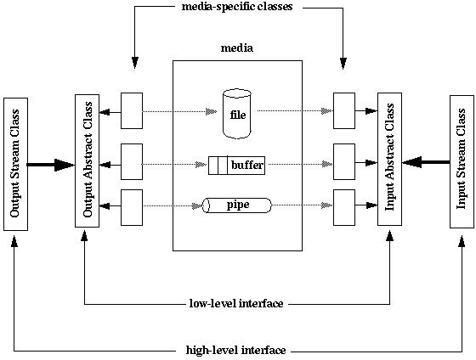
Conclusion
After completion of this segment you should know:
How to serialize Java objects.
How to deserialize and construct Java objects
How to read/write objects using serialization.

